Slide 1
PGST Meeting 2/27

Slide 2
Today's Agenda
Working Assumptions for:
Estimating propane consumption by unit and building
Refining linear regression to build heating profile
Updated Regression Results
Review energy profile progress
Updated temperature profile
Candidate Solar - Early Childhood Center
Solar Energy Credit
Next Steps

Slide 3
Working Assumptions
2023-2025 operation data is representative of current and future operation data
Propane data
Neglect small propane deliveries (<200 gal)
Propane deliveries per month = monthly propane use
Unit efficiencies match plate information
Temperature data
Data from NOAA is accurate (Bremerton station)
Average daily temperature <60°F is HDD

Slide 4
Working Assumptions (Cont.)
Building Performance
Site EUI values match medians from Building Performance Database
Building heating demand = square footage × EUI
Regression
Linear regression models heat and propane usage
Non-heating propane use (stoves, DHW) has no seasonal variation
Space heating energy is attributable to the Longhouse, Education Center, CFS and Gym buildings (no extra losses from tank, pipes, etc.)

Slide 5
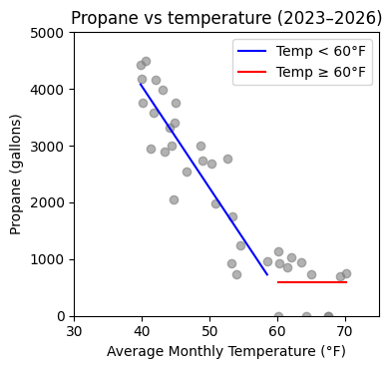
Updated Regression Results
Baseline of 589.3 gallons/month includes stoves and DHW loads (647 MMBtu/yr)
Running stove at max capacity (180,000 Btu/hr) for 3 hours/day, 5 days/week = 140 MMBtu/yr
Current profiles based on this analysis - lowering baseline may improve accuracy

Slide 6
Updated Regression Results
Building | Area (ft²) | Heater efficiency | Site EUI (kBTU/ft²-yr) | Annual fuel energy (MMBtu/yr) | Propane allocation:
Longhouse | 6000 | 83% | 112.9 | 677.2 | 27.8%
Education Center | 4060 | 83% | 83.7 | 339.7 | 13.9%
CFS | 6681 | 80% | 92.9 | 620.5 | 25.5%
Gym | 7700 | 81% | 19.9 | 153.5 | 6.3%
Stoves/DHW/misc. | - | - | - | 647.0 | 26.5%

Slide 7
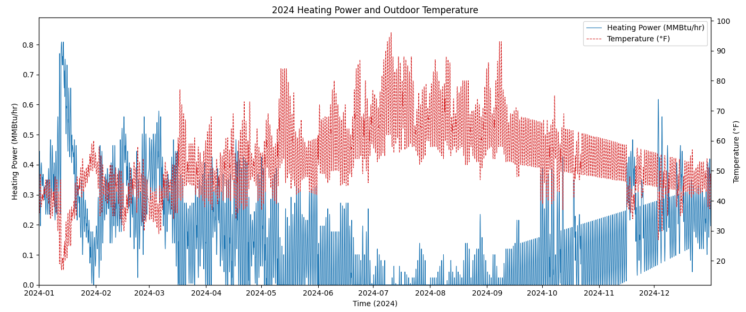
Heating Load Profile

Slide 8
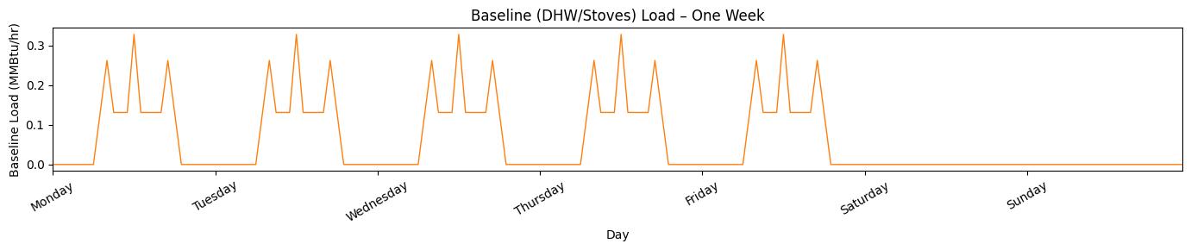
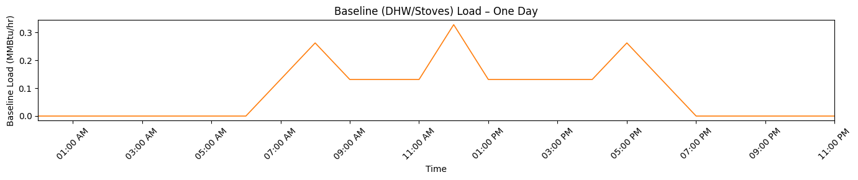
Stoves/DHW Load Profile

Slide 9
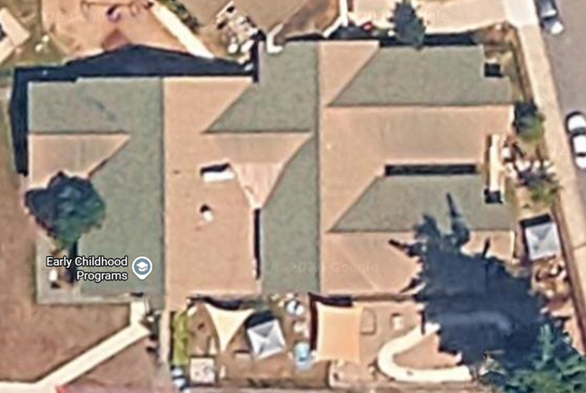
Candidate Solar - Early Childhood Center
PV Watts Area: 814 m²
PV Watts Capacity: 154.9 kW-dc
Direction:
N, W, E, and S-facing roofs
Tilt:
Estimated from Google Maps
Depending on the roof, ranging from ~21-24°

Slide 10
Candidate Solar - Roof Estimates
Roofs | Direction | PVWatts area (m²) | PVWatts capacity (kWdc) | Tilt | Notes
S1 | S | 52 | 10.0 | 24° | Partially blocked by a tree
S2 | S | 150 | 28.5 | 22° | Partly shaded by a tree
W1 | W | 132 | 25.1 | 23° | Partially blocked by a tree
W2 | W | 87 | 16.6 | 21° | -
E1 | E | 142 | 27.1 | 23° | -
E2 | E | 69 | 13.0 | 21° | -
N1 | N | 53 | 10.0 | 24° | -
N2 | N | 129 | 24.6 | 22° | Partly shaded by a tree
Total | - | 814 | 154.9 | - | -
W2
E2
N2
N1
N1
S1
S2
S1
E2
W1
N2
W2
E1
S2
E2

Slide 11
Net Billing: Solar Energy Credit
Solar Energy Credit
According to the solar energy credit, net billing is at $0.067130/kWh, which was applied to ReOpt
Lower life cycle cost savings
When evaluated in ReOpt without a battery, the life cycle cost savings were nearly a third less (~$190K compared to ~$290K over 25 years)

Slide 12
Net Billing: Solar Energy Credit
Use net billing in ReOpt based on PSE switchover?
PSE website says they discontinued net metering at the end of 2025
ReOpt PV Optimization
ReOpt optimizes the solar installation at max specified size (100 kW, based on state restrictions)
We could adjust this by setting a new max
This is due to the assumption of no capital cost and no limit to net billing

Slide 13
Next Steps
Refine baseline, non-heating propane consumption for more accuracy
ReOPT parameter sweep
Separate load profiles for each building
Heat pump fitting

Slide 14
Thank you!

